Slide 1
Ground rules
Sustainable
Our PPTs default mode is dark. Energy saved in every slide. Navigate through the bright cover slides and use the Knowit-black-background for everything else.
Accessible
Our columns are narrow and line lengths short for an easy, and accessible read
Keep it simple
Highlight only what strengthens your story. Leave everything else behind. And make every illustration count ☺

Slide 2
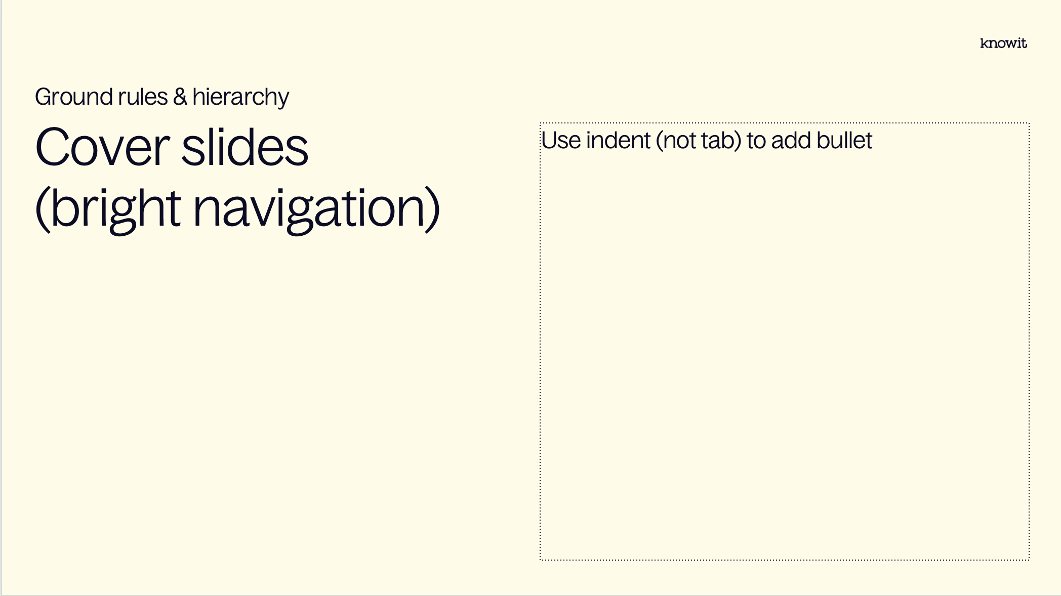
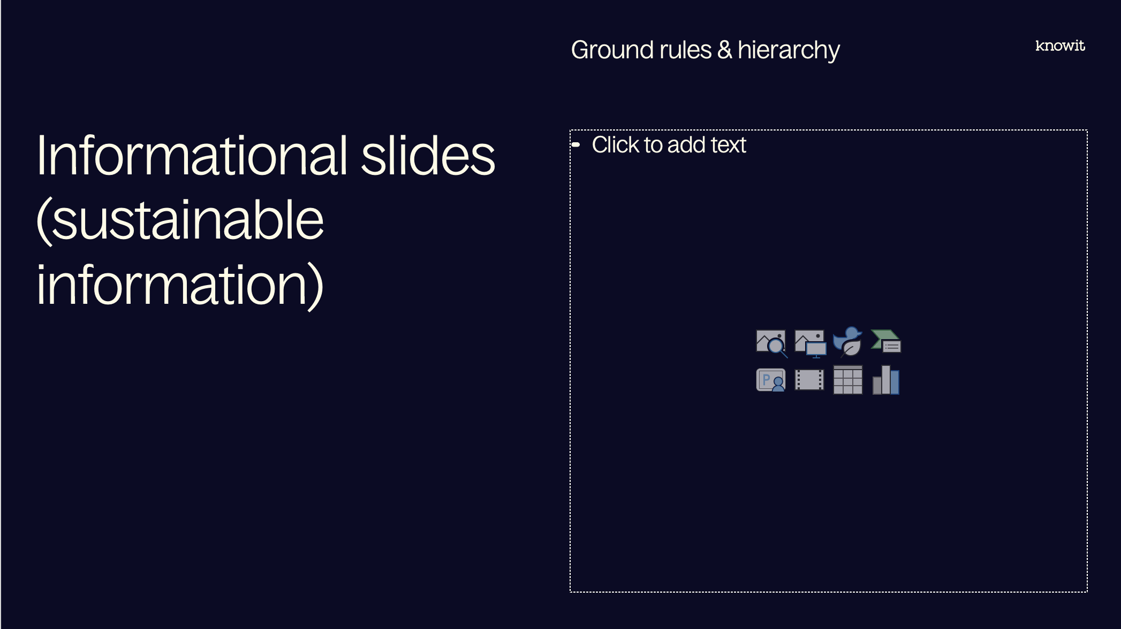
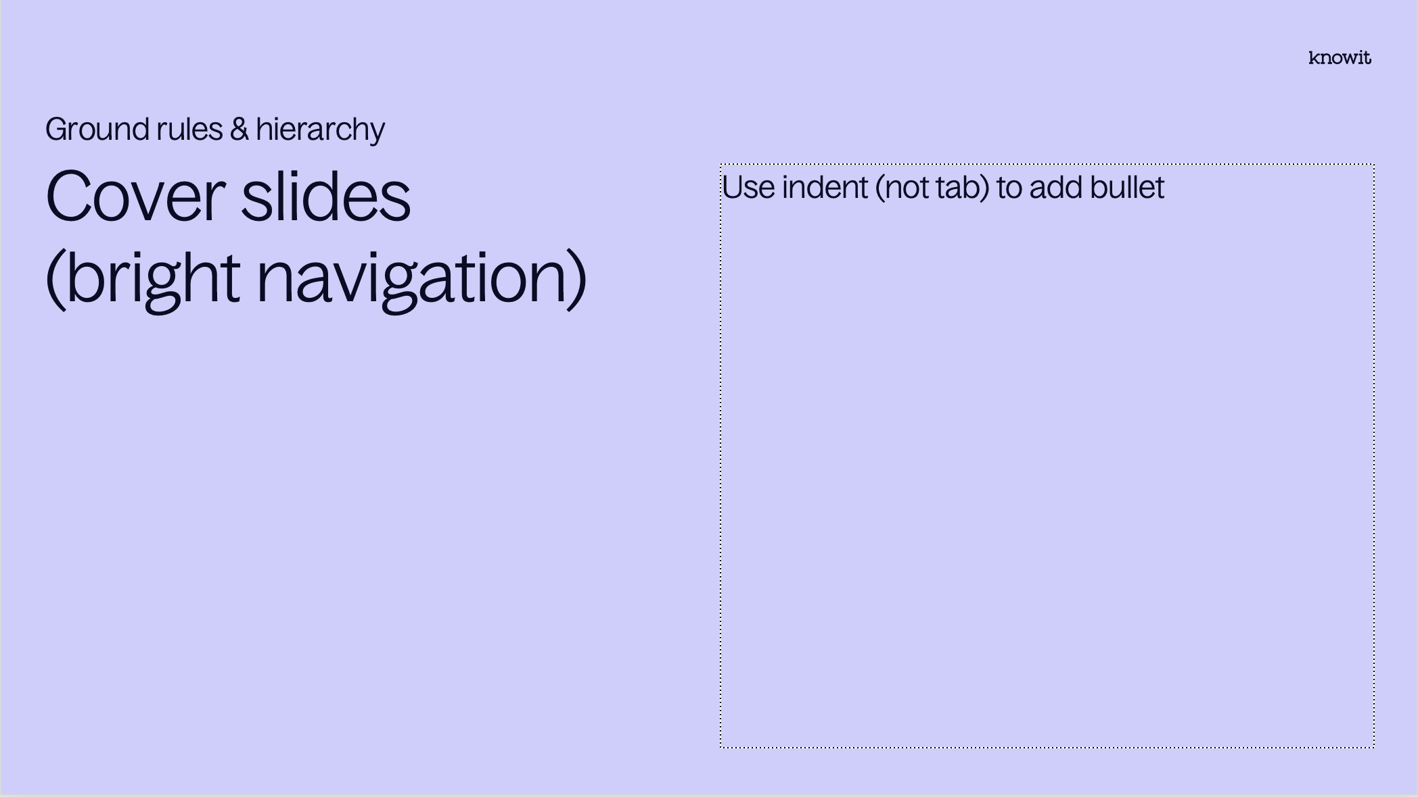
Visual prioritization

Slide 3
PowerPoint skills
Tips
Our template contains 38 different layouts, choose with care (and ask a colleague if you can’t find them)
The layout names might be helpful
Confused about colors or typographic rules? Check out the margins for some guidance
Have fun! (Break some rules if it helps you elevate your kick-ass-content☺)

Slide 5
Embedded academy Communication interfaces

Slide 6
Content
Introduction
SPI
UART
I2C
Jtag
CAN?
Others?
Other topics

Slide 7
Lab
Introduction
In today’s lab we will implement a small uart interface to communicate with a PC-program

Slide 8
Notes from previous session

Slide 9
Reminder for today
Notes from last session
Stack
Flash

Slide 10
SPI

Slide 11
SPI
SPI
Serial peripheral interface
Used for short distance communication between integrated circuits
Master-slave configuration
Commonly used for flash, DAC, Eeprom etc.

Slide 12

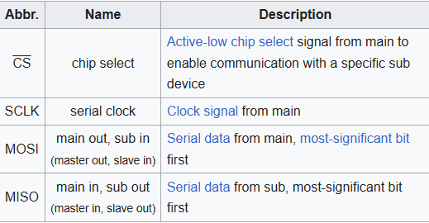
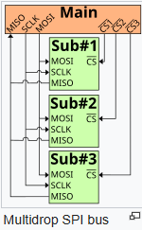
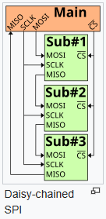
How it works
SPI
Every clock cycle, main and sub shifts out one bit and reads one bit.
After 8 cycles one byte is transmitted

Slide 13

Pros and cons
SPI
Pros
Good signal integrity
High throughput
Full duplex (both can transmit and receive simultaneously)
Simple hardware
Low power
Cons
Only handles short distances
No formal protocol
No interrupts
No flow control
No acknowledgement
No error check

Slide 14
I2C

Slide 15
I2C
I2C
Inter-integrated circuit
Used for short distance communication between integrated circuits
Master-slave configuration
Commonly used for flash, DAC, Eeprom etc.

Slide 16
Jtag

Slide 17
UART

Slide 18
CAN

Slide 19
Other?

Slide 20
Other topics related to the course?

Slide 21
Questions?

Slide 22
Lab part

Slide 23












































































Our icons

Slide 24

















UN SDG (PNG)

Slide 25

















UN SDG (SVG)

